Slide 1
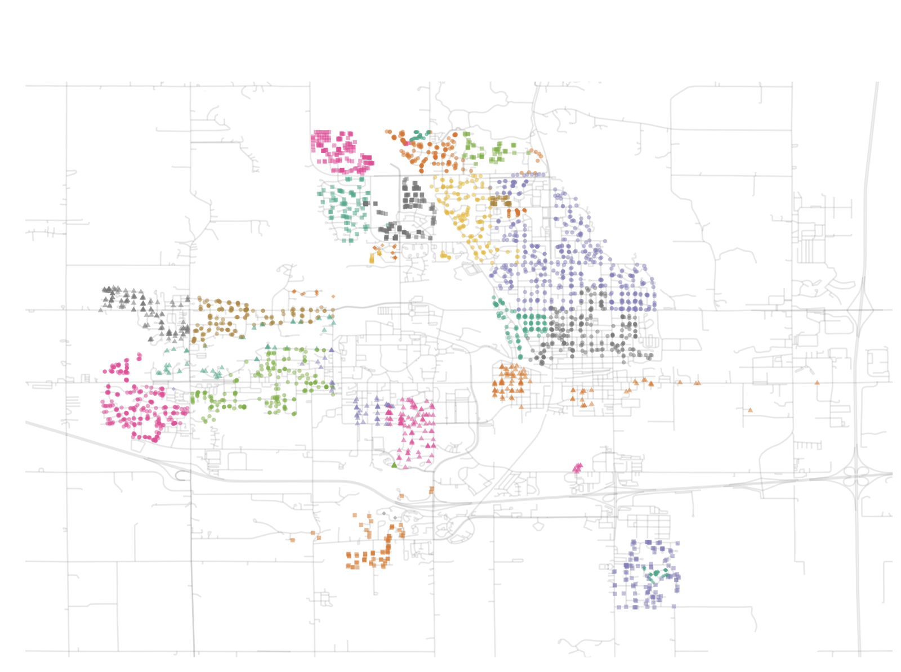
AMES HOUSING DATA
DAMAR SHIPP JR

Slide 2
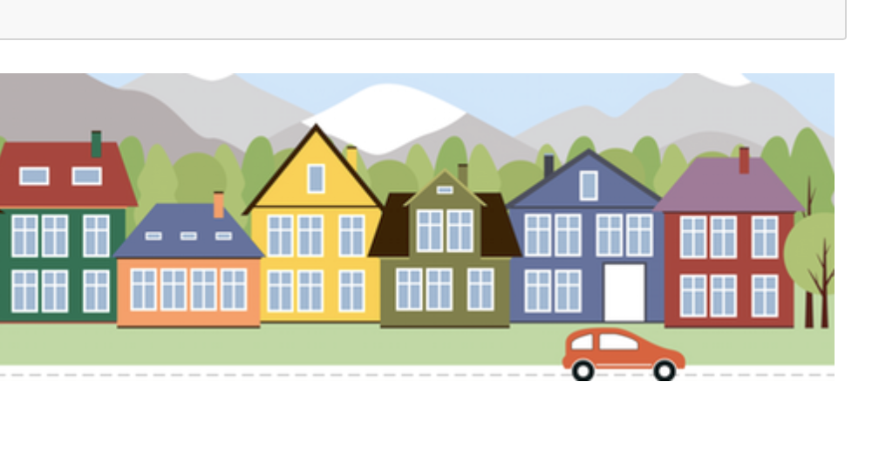
Purpose
Purpose
Housing prices are influenced by numerous factors such as the year it was built, the number of bedrooms, neighborhoods, and more. The goal is to create a model that can predict the price of the houses based on these variables with high accuracy. Given the string of data and complexity to find the potential correlations between variables, this problem involves both variable selection and the application of machine learning techniques to return accurate predictions.

Slide 3
TABLE OF CONTENTS
4
Objective Overview
5
Model Explanation
6
Data Overview/ Findings
8
Next Steps
9
Summary/ Conclusion

Slide 4
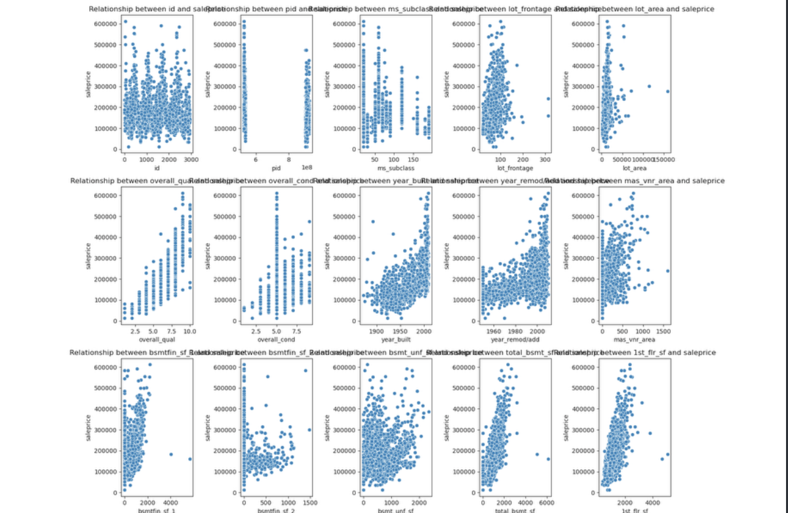
Objective Overview
Objective: Housing prices are influenced by numerous factors such as the year it was built, the number of bedrooms, neighborhoods, and more. . The goal is to create a model that can predict the price of the houses based on these variables with high accuracy.

Slide 5
Model Explanation
The model used in this project is a Linear Regression with Lasso Regularization to prevent overfitting and to improve the model's capability to generalize. Lasso regression was selected because it helps in selecting important variables.
Steps involved(Key steps):
Preprocessing: Missing values were identified and filled, and categorical features were encoded.
Modeling: Lasso regression was applied to predict house prices.
Evaluation: Model performance was assessed using various metrics like MSE and MAE.

Slide 6
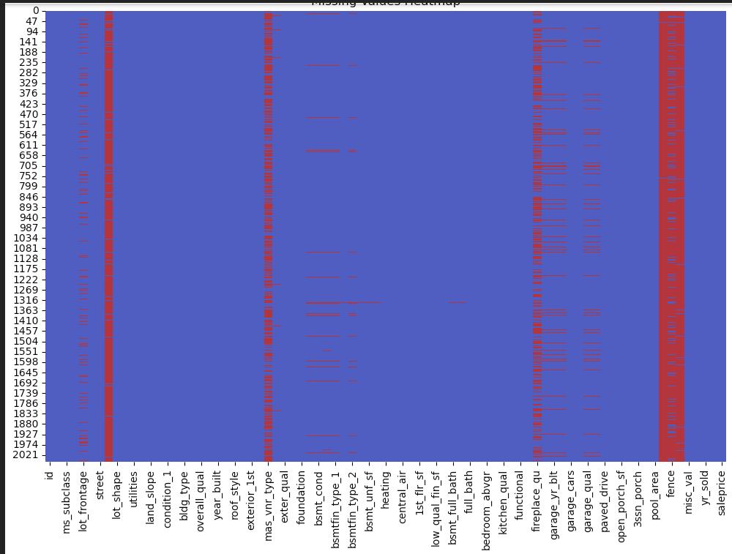
DATA
OVERVIEW
Values with heavy red helped decide it’s not enough to include in my model because they hold no significance. So I did not include it in my model.
Key Features I used: Columns from Ames Housing Data Sets
The variables that I used are listed below…
'garage_area', '2nd_flr_sf', 'year_remod/add', 'year_built', 'overall_qual', 'full_bath', 'garage_cars', 'ms_subclass', 'overall_cond', 'bsmt_unf_sf', 'totrms_abvgrd'
Values: null heatmap
Street, mas_vnr_type, fireplace_qu, pool_area, fence, misc_val

Slide 7
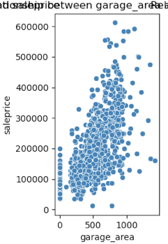
FINDINGS
DATA SEARCH
Discoveries:
Variables that had a higher min value as it increased in value I included it in my model in hopes it would provide the most accuracy.
Though we are only looking at the garage size, this is a representation of what I followed when putting together my model.

Slide 8
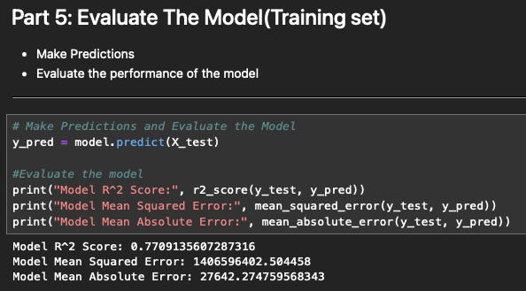
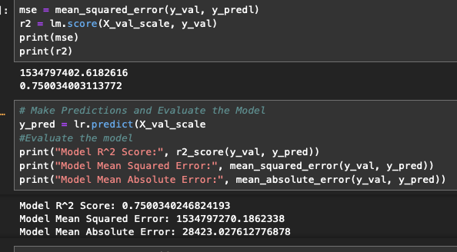
FINDINGS
Model Performance
Discoveries:
The variables that I decided to use the r2 seemed to remain around the same so I decided to keep this model as the consistency remained relatively close to each other.
Indication that there is balance in the model when using the same variables from different datasets.

Slide 9
NEXT STEPS
Future Enhancements:
Tune Parameters: Further optimize model performance.
Feature Expansion: Add/remove more variables for possibly better predictions.
Compare with Other Models:

Slide 10
SUMMARY
My model enables real estate professionals to closely assess properties based off of a select variables more accurately. Though my model needs work It places your possibility over 70%.

Slide 11
THANK YOU

